Slide 1

Prioritizing what to work on: Spam classification example
Machine learning system design
Machine Learning

Slide 2
Building a spam classifier
From: cheapsales@buystufffromme.com
To: ang@cs.stanford.edu
Subject: Buy now!
Deal of the week! Buy now!
Rolex w4tchs - $100
Med1cine (any kind) - $50
Also low cost M0rgages available.
From: Alfred Ng
To: ang@cs.stanford.edu
Subject: Christmas dates?
Hey Andrew,
Was talking to Mom about plans for Xmas. When do you get off work. Meet Dec 22?
Alf

Slide 3
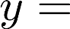
Building a spam classifier
Supervised learning. features of email. spam (1) or not spam (0).
Features : Choose 100 words indicative of spam/not spam.
From: cheapsales@buystufffromme.com
To: ang@cs.stanford.edu
Subject: Buy now!
Deal of the week! Buy now!
Note: In practice, take most frequently occurring words ( 10,000 to 50,000) in training set, rather than manually pick 100 words.

Slide 4
Building a spam classifier
How to spend your time to make it have low error?
Collect lots of data
E.g. “honeypot” project.
Develop sophisticated features based on email routing information (from email header).
Develop sophisticated features for message body, e.g. should “discount” and “discounts” be treated as the same word? How about “deal” and “Dealer”? Features about punctuation?
Develop sophisticated algorithm to detect misspellings (e.g. m0rtgage, med1cine, w4tches.)

Slide 5
Error analysis
Machine learning system design
Machine Learning

Slide 6
Recommended approach
Start with a simple algorithm that you can implement quickly. Implement it and test it on your cross-validation data.
Plot learning curves to decide if more data, more features, etc. are likely to help.
Error analysis: Manually examine the examples (in cross validation set) that your algorithm made errors on. See if you spot any systematic trend in what type of examples it is making errors on.

Slide 7
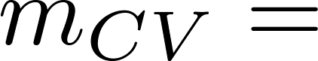
Error Analysis
500 examples in cross validation set
Algorithm misclassifies 100 emails.
Manually examine the 100 errors, and categorize them based on:
What type of email it is
What cues (features) you think would have helped the algorithm classify them correctly.
Pharma:
Replica/fake:
Steal passwords:
Other:
Deliberate misspellings:
(m0rgage, med1cine, etc.)
Unusual email routing:
Unusual (spamming) punctuation:

Slide 8
The importance of numerical evaluation
Should discount/discounts/discounted/discounting be treated as the same word?
Can use “stemming” software (E.g. “Porter stemmer”)
universe/university.
Error analysis may not be helpful for deciding if this is likely to improve performance. Only solution is to try it and see if it works.
Need numerical evaluation (e.g., cross validation error) of algorithm’s performance with and without stemming.
Without stemming: With stemming:
Distinguish upper vs. lower case (Mom/mom):

Slide 9
Error metrics for skewed classes
Machine learning system design
Machine Learning

Slide 10
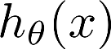
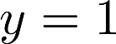
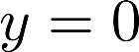
Cancer classification example
Train logistic regression model . ( if cancer, otherwise) Find that you got 1% error on test set.
(99% correct diagnoses)
Only 0.50% of patients have cancer.
function y = predictCancer(x)
y = 0; %ignore x!
return

Slide 11
Precision/Recall
in presence of rare class that we want to detect
Precision
(Of all patients where we predicted , what fraction actually has cancer?)
Recall
(Of all patients that actually have cancer, what fraction did we correctly detect as having cancer?)

Slide 12
Trading off precision and recall
Machine learning system design
Machine Learning

Slide 13
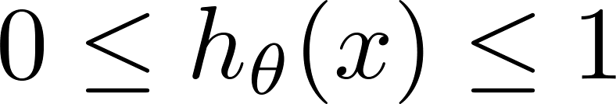
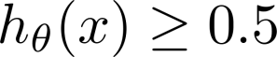
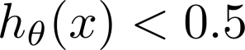
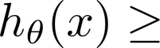
Trading off precision and recall
precision =
true positives
no. of predicted positive
Logistic regression:
Predict 1 if
Predict 0 if
recall =
true positives
no. of actual positive
Suppose we want to predict (cancer)
only if very confident.
1
Precision
0.5
Suppose we want to avoid missing too many cases of cancer (avoid false negatives).
0.5
1
Recall
More generally: Predict 1 if threshold.

Slide 14
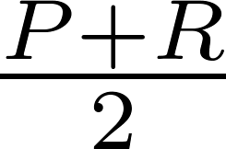
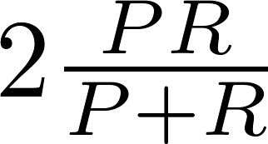
F₁ Score (F score)
How to compare precision/recall numbers?
 | Precision(P) | Recall (R) | Average | F₁ Score
Algorithm 1 | 0.5 | 0.4 | 0.45 | 0.444
Algorithm 2 | 0.7 | 0.1 | 0.4 | 0.175
Algorithm 3 | 0.02 | 1.0 | 0.51 | 0.0392
Average:
F₁ Score:

Slide 15
Data for machine learning
Machine learning system design
Machine Learning

Slide 16
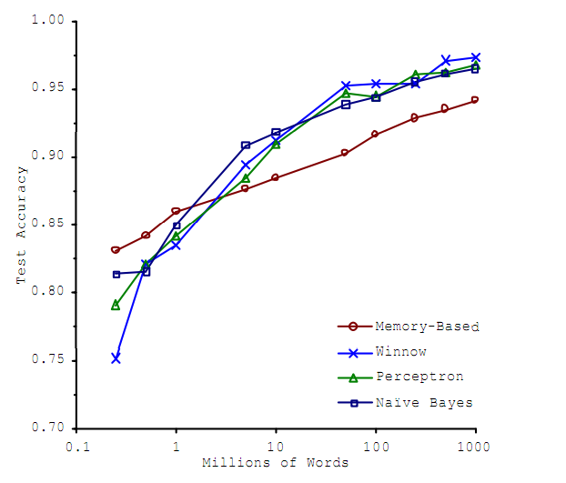
Designing a high accuracy learning system
E.g. Classify between confusable words.
{to, two, too}, {then, than}
For breakfast I ate _____ eggs.
Algorithms
Perceptron (Logistic regression)
Winnow
Memory-based
Naïve Bayes
Accuracy
Training set size (millions)
“It’s not who has the best algorithm that wins.
It’s who has the most data.”
_{[Banko and Brill, 2001]}

Slide 17
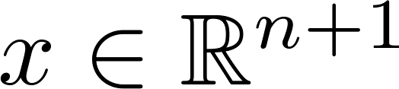


Large data rationale
Assume feature has sufficient information to predict accurately.
Example: For breakfast I ate _____ eggs.
Counterexample: Predict housing price from only size (feet²) and no other features.
Useful test: Given the input , can a human expert confidently predict ?

Slide 18
Large data rationale
Use a learning algorithm with many parameters (e.g. logistic regression/linear regression with many features; neural network with many hidden units).
Use a very large training set (unlikely to overfit)

Slide 19
Artificial data synthesis
Machine learning system design
Machine Learning

Slide 20
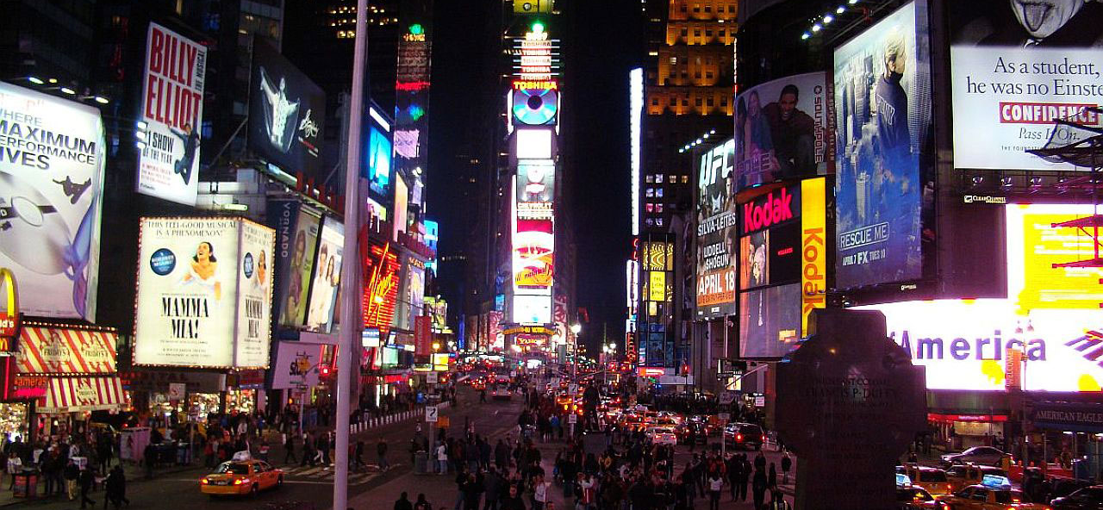
Artificial data synthesis for photo OCR
[http://www.publicdomainpictures.net/view-image.php?image=5745&picture=times-square]

Slide 21
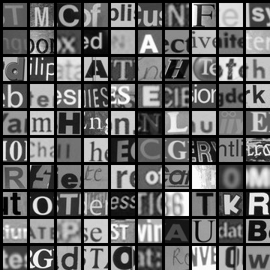
Artificial data synthesis for photo OCR
Abcdefg
Abcdefg
Abcdefg
Abcdefg
Abcdefg
Real data
[Adam Coates and Tao Wang]

Slide 22
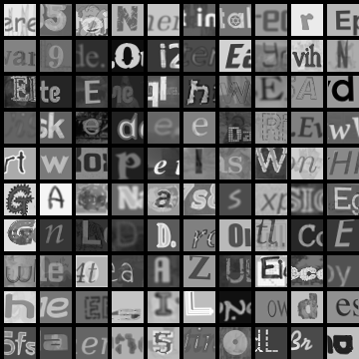
Artificial data synthesis for photo OCR
Real data
Synthetic data
[Adam Coates and Tao Wang]

Slide 23
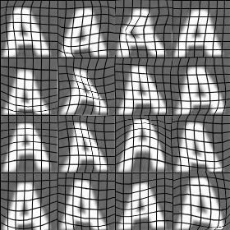
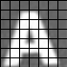
Synthesizing data by introducing distortions

Slide 24

Synthesizing data by introducing distortions: Speech recognition
Original audio (counting from zero to five)
Noisy background: Machinery
Noisy background: Crowd
Audio on bad cellphone connection
[www.pdsounds.org]

Slide 25

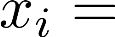
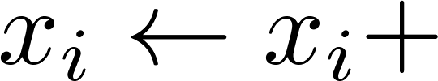
Synthesizing data by introducing distortions
Distortion introduced should be representation of the type of noise/distortions in the test set.
Audio:
Background noise,
bad cellphone connection
Usually does not help to add purely random/meaningless noise to your data.
intensity (brightness) of pixel
random noise
[Adam Coates and Tao Wang]

